Slide 1
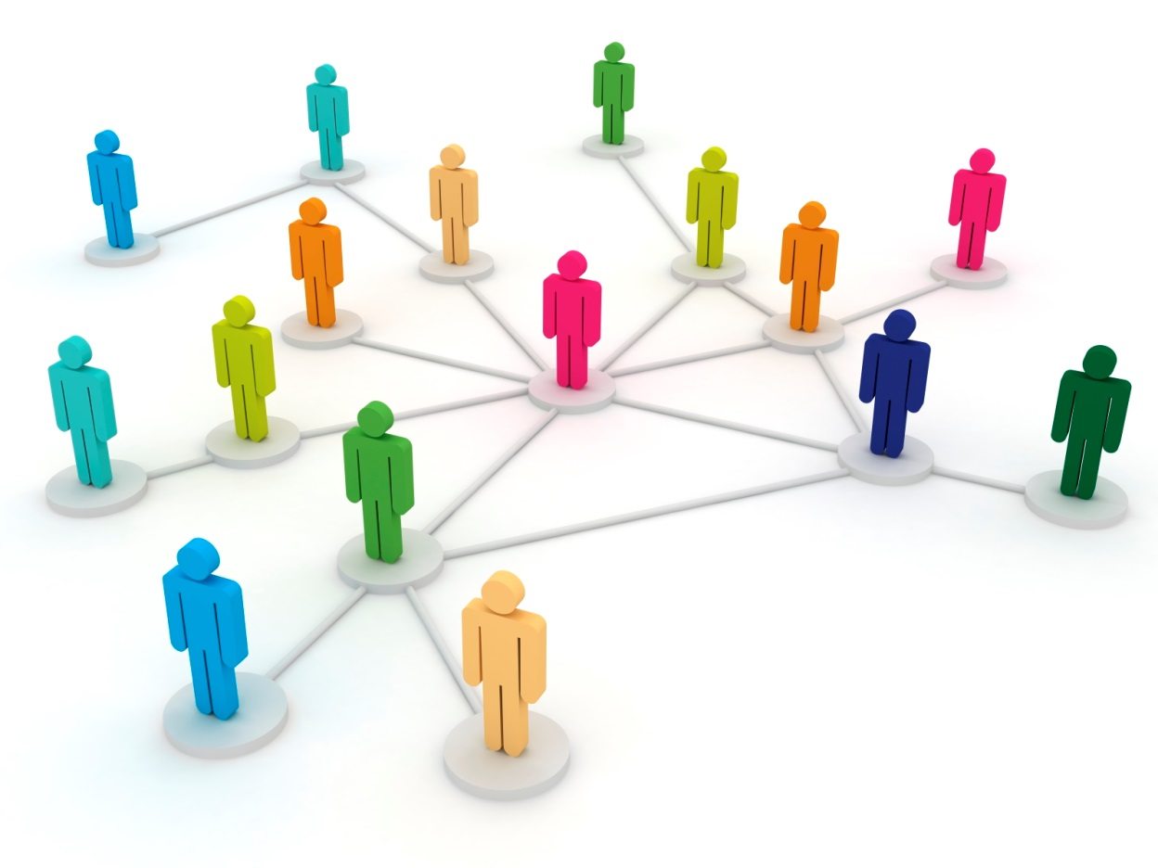
Peer Review and its Discontents
Sabine Hossenfelder
Frankfurt Institute for Advanced Studies

Slide 2
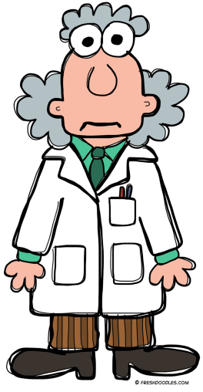
The Discontents
In this lecture I will discuss
Why so many scientists are unhappy with peer review.
What problems this brings.
And what we can do to solve these problems.
Idiots.

Slide 3
What I talk about
With “peer review” I mean not only the review of papers, but also proposals, projects, applications.
I will focus on academia, non-profit research.

Slide 4
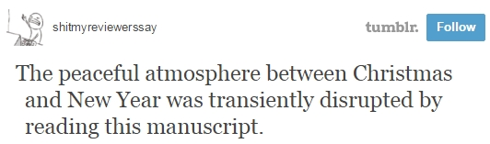
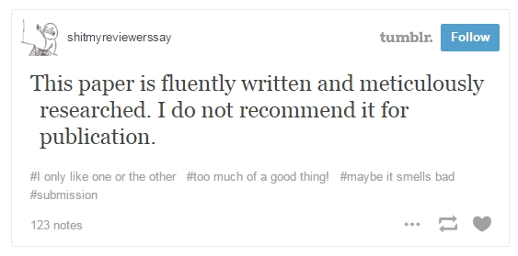
We ♥ to hate Peer Review
For more follow @YourPaperSucks

Slide 5
We ♥ to hate Peer Review
This is funny.
But it also signals that complaints about peer review are very common and widely spread.
How much are scientists concerned about this?

Slide 6
Quantifying Unhappiness
In 2008 I conducted a survey among active physicists in the USA and Canada.
A total of 1815 people filled out the survey.
This corresponds to a response rate of 14.42%.
The following outcome stunned me.

Slide 7
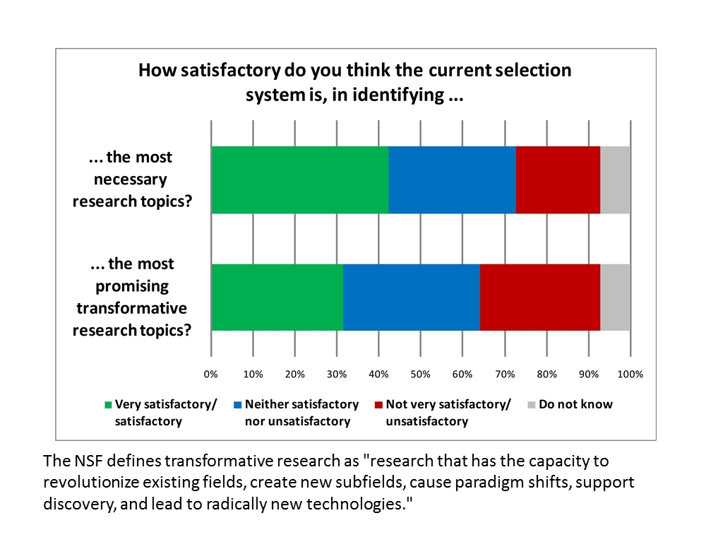

Slide 8
Tensions
This means less than 1/3 of physicists think that transformative research is identified very satisfactorily or satisfactorily. Only slightly more for other research.
Ie: Most don’t believe the current system works well.
Everyting sucks.

Slide 9
Shortcomings of Peer Review
Are a symptom, not the disease.
Scientists want good science.
Peer review is necessary for good science.
If peer review is ailing, this signals that
The scientific system is not working correctly.

Slide 10
The Problem
The scientific system is not able to self-optimize “good science” because individual incentives are not aligned with the collective goal.
This is a bottom-up problem.
It can’t be fixed top-down.
Ie, it’s all your fault.
wtf?

Slide 11

Example for Collective Problem

Slide 12
Example for Collective Problem
My incentive is to shove you all aside, and get out.
If we all do this, we’ll end up beating each other up rather than getting out.
Align incentives with collective goal: Remind people to exit orderly.
The situation isn’t always that obvious.

Slide 13
Collective Problems
It can be difficult for the individual to anticipate emergent behavior. Even if possible there is the
Collective action problem.
If individual incentives conflict with collective goals, people put themselves first.
I’m only being rational.

Slide 14
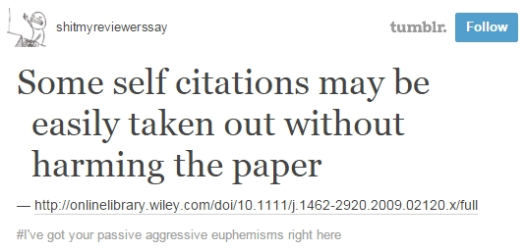
We ♥ to hate Peer Review

Slide 15
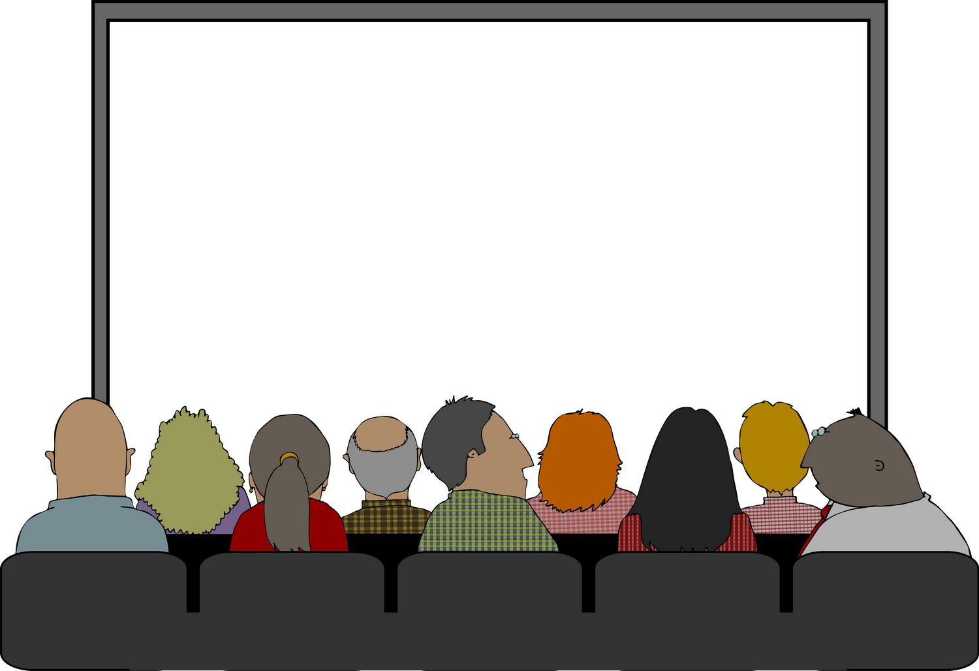
Collective Problems
Nobody wants to put themselves at a disadvantage.
The result is lots of talk and no change.

Slide 16
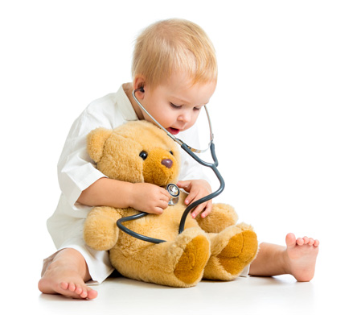
Symptoms

Slide 17
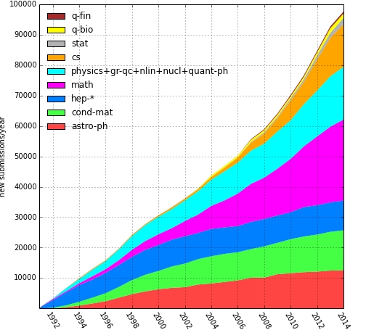
Shortcomings of Peer Review
I work in theoretical high energy physics.
For various reasons I believe this field is particularly bad: high competition, traditionally fad-driven, very tightly connected
It’s a good case study.
Nobody has time to read all new papers.
Nobody has time to read ~300 application documents in 2 weeks
Filters are necessary.
It is pointless to complain about filters, metrics, and measures. They’re here to stay.

Slide 18
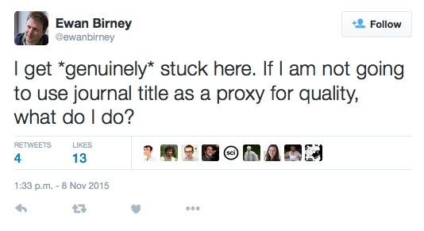
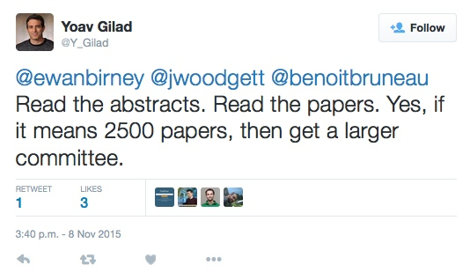
We ♥ to hate Peer Review
This isn’t realisistic.

Slide 19
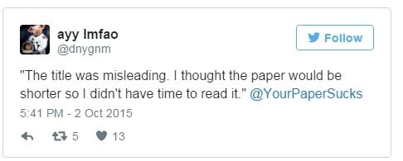
We ♥ to hate Peer Review
This is realisistic.

Slide 20
Shortcomings of Peer Review
Only available filters: renown authors, personal referral, journal references, publicity.
Promotes a rich-get-richer trend.
Most papers never get read. On a voluntary basis, most paper would not be peer reviewed.
Voluntary peer review will only make it worse.

Slide 21
Shortcomings of Peer Review
The shortcomings of peer review prevent the scientific system from working optimally:
Good ideas can go unnoticed.
Fads and fashions are amplified.
Errors are not corrected and may repeat.
This wastes time, money, and effort.
Nothing wrong with
fashions in general!

Slide 22
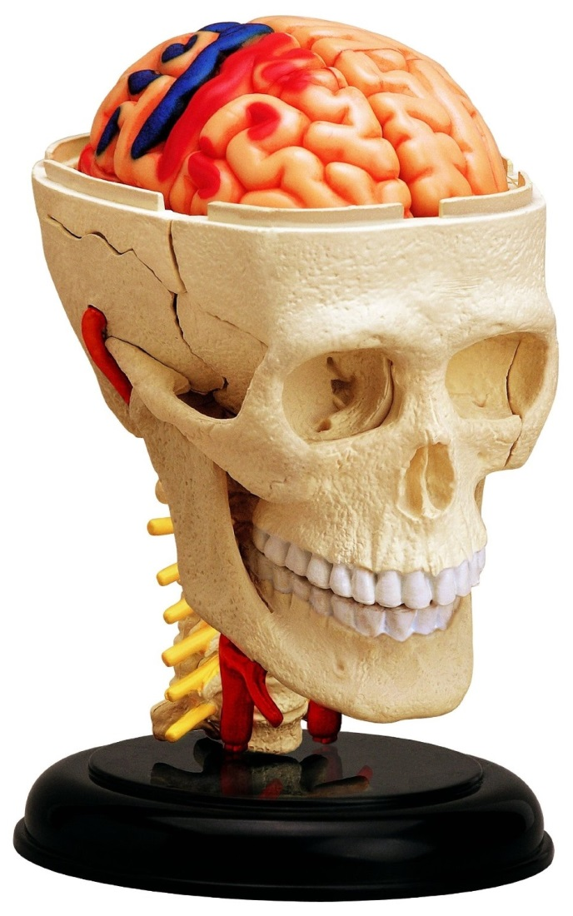
The Anatomy of the Scientific System
We need the language to talk about this.

Slide 23
Modelling Knowledge Discovery
Science is an adaptive system. Adaptive systems optimize a set of elements by repeating for steps:
Modify
Track change
Assess change
Respond

Slide 24
Optimization in Landscape
3.Assess
V(x+Δx) >V(x) ?
4.Respond
V(x)
V(x+Δx)
2. Track
x
x+Δx
1. Modify

Slide 25
Example: Free Market Economy
Modify
Track change
Assess change
Respond
Alter goods
or prices.
Reconsider action.
Optimizes
“utility”
Measure profit.
Compare profits.

Slide 26
Example: Free Market Economy
In the optimal state, all goods have their “real” value (that’s a definition).
It is a self-organized system “invisible hand” but it
requires a suitable configuration
No hidden information, no lies, honoring contracts, no monopolies...

Slide 27
Example: Natural Selection
Modify
Track change
Assess change
Respond
Alter genes.
Extinction or reproduction.
Optimizes
“fitness”
Number of offspring (that can reproduce).
Survives or doesn’t.

Slide 28
Modeling Knowledge Discovery
Alter hypotheses
or project.
Reconsider action.
Modify
Track change
Assess change
Respond
Optimizes
“good science”
Data enters here
Notice peer’s reaction.
Is it useful or not?

Slide 29
Modelling Knowledge Discovery
This 4-step circle is the heart of the scientific method.
But each step can fail or work inefficiently.
Modify
Track change
Assess change
Respond
Needs: Guidelines for scientific conduct, quality standards, hypothesis pre-selection... Most important:
It needs objective expert judgement.

Slide 30
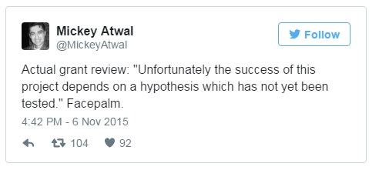
We ♥ to hate Peer Review

Slide 31
Free Scientific System
Optimizes “good science.” In the optimal state, all scientists do their “best science” – that’s a definition.
It is a self-organized system “invisible hand” but it too requires a suitable set up:
Objective judgement: No bias, no marketing, no distortion of incentives by artificial pressure.

Slide 32
What means self-organized?
That a system is self-organized means it is able to optimize its operation towards maximal efficiency.
This doesn’t mean the system works under all circumstances.
It needs to be correctly configured.

Slide 33
What means “free”?
The scientific system has external constraints that are funding priorities imposed by funder’s interests (often: governments).
This makes the system less effective because there will be less return on investment if researchers overpopulate highly funded fields. How much of this is desirable is a political question.
I am here only concerned with the optimization given these constraints.

Slide 34

Diagnose

Slide 35
We ♥ to hate Peer Review
Some more data from that survey I conducted

Slide 36
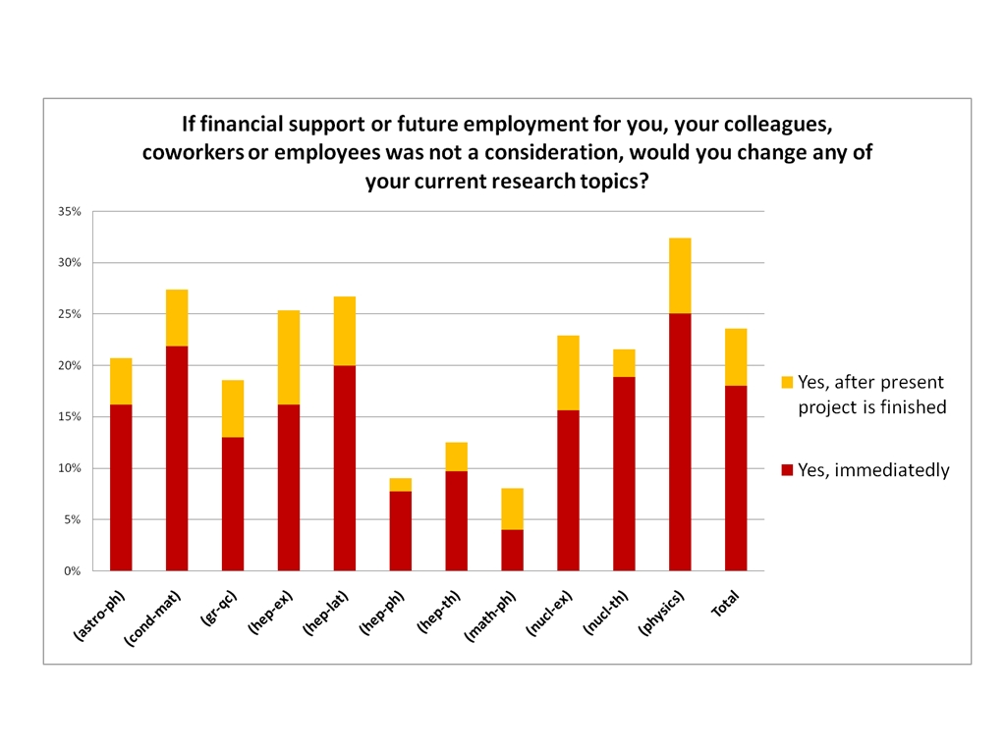

Slide 37
Tensions
About a quarter of physicists work on topics they do not think are the most promising.
How can you expect this system to optimize good science?
What is good science anyway?

Slide 38
What is good science?
Good science is what scientists do if they are able to freely follow their expert’s opinion.
Provided they do their best to be objective.

Slide 39
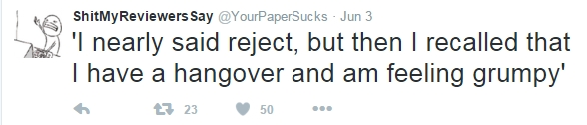
We ♥ to hate Peer Review

Slide 40
Diagnose
Scientists fail to protect their objectivity.
The result is that individual and collective incentives are no longer aligned.
I call it the
Irritable Scientist Syndrom.
The scientist is irritable because they want to do good science, but that’s not good for their career.

Slide 41
The Origin of the Problem
That’s how it is.
1. Scientists don’t recognize the problem
2. They don’t recognize it can be solved
System justification, just-world bias
3. They have no reason to solve it
4. They don’t have time to solve it
Status quo bias, appeal to tradition
Double bind
Survivor bias, projection bias
That’s the system.
I have no problem, so there is no problem.
Catch 22.

Slide 42
Some Existing Problems
Can’t/won’t retrain
Modify
Track change
Assess change
Respond
No culture of
debate and
criticism
Loss aversion
Group think, motivated cognition

Slide 43
The four pressures
Scientists are not free to follow interests due to:
Financial pressure: Project work, need to bring in grant money
Time pressure: Short-term contracts, overwork
Peer pressure: Group-think, streamlining
Public pressure: Necessity to appear relevant in public perception

Slide 44
The Problem with Bad Measures
Derived secondary criteria always deviate from primary goals
Primary goal
Secondary criterion

Slide 45
Why Now?
Problems are amplified because:
Community grows
It is better connected
Fewer long-term positions
More public exposure
Adaptation missing
But it has always worked!

Slide 46
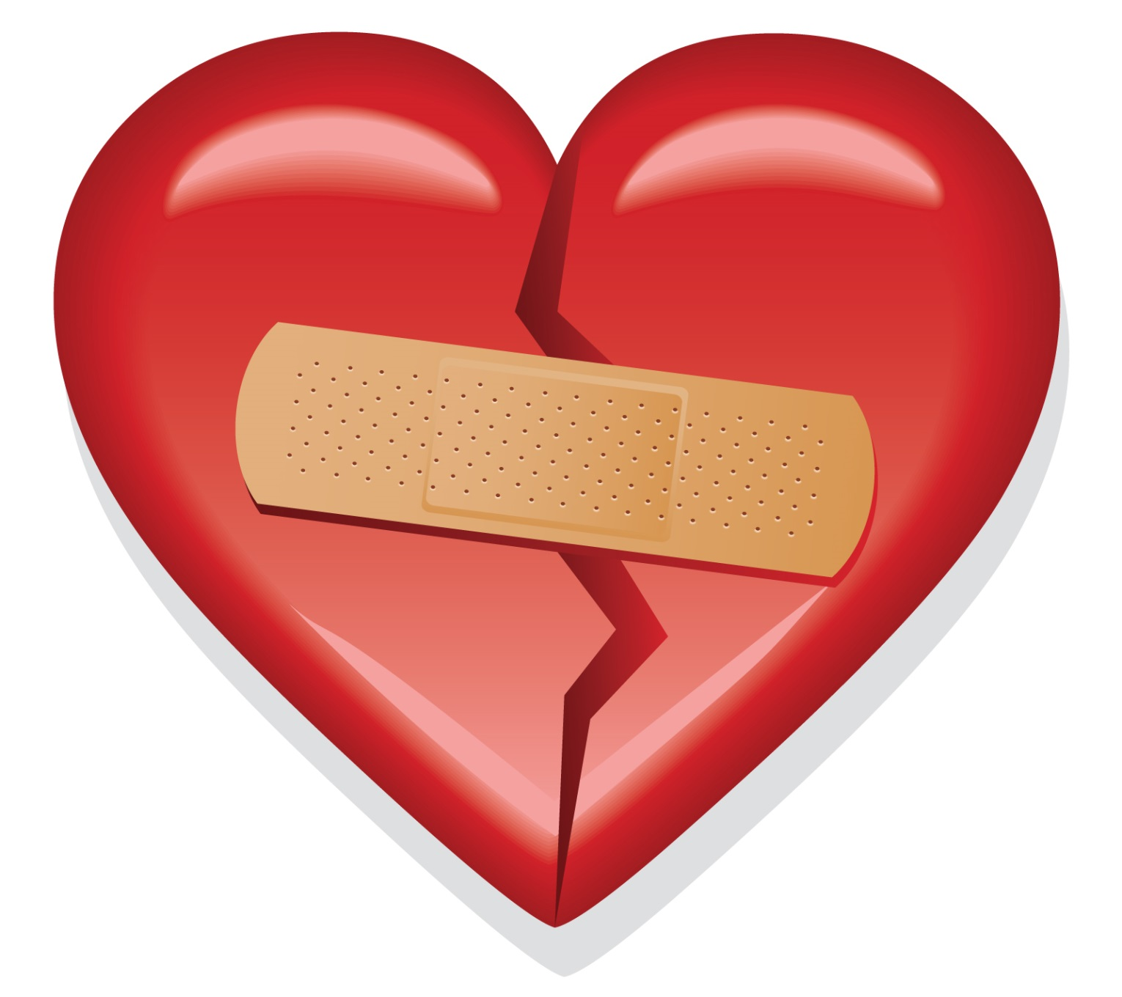
Cure

Slide 47
The Cure #1: Feedback
Individuals need better understanding about how individual actions contribute to collective trends. They need
Knowledge about knowledge discovery.
This means education about: Social bias, cognitive bias, decision making in groups, sociology of science... And data, data, data!
Not saying nobody works on this! But existing knowledge is disconnected from practice of science.

Slide 48
The Cure #2: Adapt
Individuals need measures (filters, metrics) for assessment of projects, publications, people.
Measures need to be internal:
For scientists (in peer review)
Personal (individually designed)
Local (adapted to their institution’s needs)
Transparent (self-assembled)
No global, top-down, uniform measures.

Slide 49
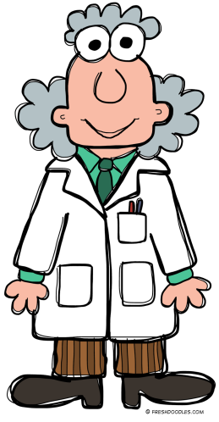
Summary
Don’t cure symptoms, cure the disease
Diagnosis: Failure to protect objectivity.
Cure#1: Knowledge about knowledge discovery
Cure#2: Adaptation to changing circumstances.

